Slide 1
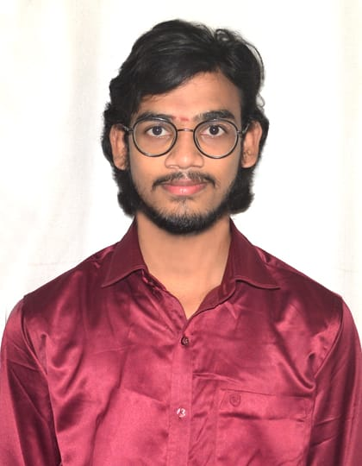

DULAM MANIKANTA NAIDU
Bachelor of Technology,
Electronics and communication Engineering : 2018-22
Analyst
iTransfrom L&D Left Shift Batch
Certification:
AZ-900 Fundamental.
Mumbai
Skills
DULAM-MANIKANTA.NAIDU@CAPGEMINI.COM
+91 9640655481
C# | Basics, OOPS, Exception Handling ,Arrays ,Collection and Generics
.NET Framework | ADO.NET,ASP.NET with MVC5 and WEB API, Entity Framework
Ado.net | Basics Architecture
Database | SQL Server
Tools | GIT , Swagger
UI Technology | HTML5 ,CSS & Angular
Add On Skills | Communication Skills, Team Management
A4
Full Stack Developer
Understanding of RDMS concepts using SQL Server.
Practical understanding of C# and SQL concepts using Visual Studio and SQL Server
Hands on experience in developing applications using .NET Framework, ADO.NET Core
Understanding of HTML5 , CSS and Angular Cli
Completed case study on Crop Deal which is a Web based System. Crop Deal is implemented to make farmer’s life easier by advertising their crops and sell them directly to the dealer, as it neglects all The commissions’ farmers pays to sell their crops. The main objective of Crop deal is to act as bridge between farmer and the dealer by registering famer and dealer and farmer will list their crops and the dealer will able to make payment directly to farmer’s account.
Technologies used:
ANGULAR
ASP.NET CORE
Microsoft SQL Server
Video Link : Click
GitHub Link
https://github.com/sdsameer07

